Slide 1
Cell cycle Mitosis and Meiosis
B.Sc microbiology
Sem-3 MB-302 Unit-3

Slide 2
Cell Cycle
Eukaryotes have two major types of cell division: mitosis and meiosis.
Mitosis is used to produce new body cells for growth and healing, while meiosis is used to produce sex cells (eggs and sperm).
The cell cycle is an ordered series of events involving cell growth and cell division that produces two new daughter cells via mitosis.

Slide 3
In eukaryotes, the cell cycle consists of four discrete phases: G₁, S, G₂, and M.
The S or synthesis phase is when DNA replication occurs, and the M or mitosis phase is when the cell actually divides.
The other two phases — G₁ and G₂, the so-called gap phases are less dramatic but equally important.
During G₁, the cell conducts a series of checks before entering the S phase. Later, during G₂, the cell similarly checks its readiness to proceed to mitosis.
Together, the G₁, S, and G₂ phases make up the period known as interphase.

Slide 4
Cell Cycle

Slide 5
G₁ PHASE (FIRST GAP)
The first stage of interphase is called the G₁ phase (first gap) because, from a microscopic aspect, little change is visible.
However, during the G₁ stage, the cell is quite active at the biochemical level. The cell is accumulating the building blocks of chromosomal DNA and the associated proteins.
S PHASE (SYNTHESIS OF DNA)
In the S phase, DNA replication can proceed through the mechanisms that result in the formation of identical pairs of DNA molecules sister chromatids that are firmly attached to the centromeric region.
It also duplicates a microtubule-organizing structure called the centrosome.
The centrosomes help separate DNA during M phase.

Slide 6
G₂ PHASE (SECOND GAP)
During the second gap phase, or G₂ phase, the cell grows more, makes proteins and organelles, and begins to reorganize its contents in preparation for mitosis.
G₂ phase ends when mitosis begins.
M phase
During the mitotic (M) phase, the cell divides its copied DNA and cytoplasm to make two new cells.
M phase involves two distinct division-related processes: mitosis and cytokinesis.

Slide 7
Mitosis
“Mitosis is that step in the cell cycle where the newly formed DNA is separated and two new cells are formed with the same number and kind of chromosomes as the parent nucleus.”
In mitosis, the nuclear DNA of the cell condenses into visible chromosomes and is pulled apart by the mitotic spindle, a specialized structure made out of microtubules.
Mitosis takes place in four stages:
Prophase, metaphase, anaphase, and telophase.
In cytokinesis, the cytoplasm of the cell is split in two, making two new cells.
Cytokinesis usually begins just as mitosis is ending, with a little overlap. Importantly, cytokinesis takes place differently in animal and plant cells.

Slide 8
PROPHASE
During prophase, the “first phase,” the nuclear envelope starts to dissociate into small vesicles, and the membranous organelles (such as the Golgi apparatus and endoplasmic reticulum), fragment and disperse toward the edges of the cell.
The nucleolus disappears.
The centrosomes begin to move to opposite poles of the cell.
Microtubules that will form the mitotic spindle extend between the centrosomes, pushing them farther apart as the microtubule fibers lengthen.
The sister chromatids begin to coil more tightly with the aid of condensin proteins and become visible under a light microscope.
The nuclear envelope starts disintegrating.

Slide 10
METAPHASE
During metaphase, the “change phase,” all the chromosomes are aligned in a plane called the metaphase plate, or the equatorial plane, midway between the two poles of the cell.
The sister chromatids are still tightly attached to each other by cohesin proteins.
At this time, the chromosomes are maximally condensed.
Each sister chromatid develops a protein structure called a kinetochore in the centromeric region.
The proteins of the kinetochore attract and bind mitotic spindle microtubules.
all the sister chromatids will be attached via their kinetochores to microtubules from opposing poles.

Slide 11
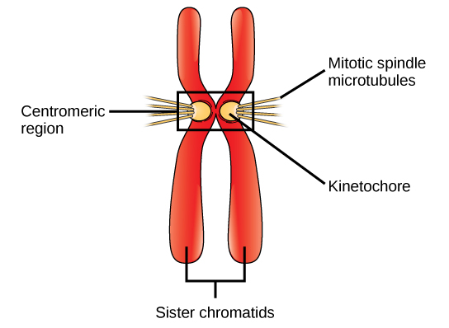

Slide 12
ANAPHASE
During anaphase, the “upward phase,” the cohesin proteins degrade, and the sister chromatids separate at the centromere.
Each chromatid, now called a chromosome, is pulled rapidly toward the centrosome to which its microtubule is attached.
The cell becomes visibly elongated (oval shaped) as the polar microtubules slide against each other at the metaphase plate where they overlap.
These sister chromatids become the chromosome of the daughter nuclei.

Slide 14
TELOPHASE
During telophase, the “distance phase,” the chromosomes reach the opposite poles and begin to decondense, relaxing into a chromatin configuration.
The mitotic spindles are depolymerized into tubulin monomers that will be used to assemble cytoskeletal components for each daughter cell.
Nuclear envelopes form around the chromosomes, and nucleosomes appear within the nuclear area.

Slide 16
CYTOKINESIS
Cytokinesis, or “cell motion,” is the second main stage of the mitotic phase during which cell division is completed via the physical separation of the cytoplasmic components into two daughter cells.
Division is not complete until the cell components have been divided and completely separated into the two daughter cells.
In cells such as animal cells that lack cell walls, cytokinesis follows the onset of anaphase. The actin filaments pull the equator of the cell inward, forming a fissure. This fissure, or “crack,” is called the cleavage furrow.
In plant cells, a new cell wall must form between the daughter cells. During interphase, the Golgi apparatus accumulates enzymes, structural proteins, and glucose molecules. The Golgi membranes become parts of the plasma membrane on either side of the new cell wall.

Slide 18
Meiosis
“Meiosis is the type of cell division that results in four daughter cells, each with half the number of chromosomes of the parent cell.”
These cells are the gametes – sperms in males and egg in females. The process of meiosis is divided into 2 stages. Each stage is subdivided into several phases.
Meiosis I:
Prophase I
Metaphase I
Anaphase I
Telophase I
Cytokinesis I
Meiosis II:
Prophase II
Metaphase II
Anaphase II
Telophase II
Cytokinesis II

Slide 19
Phases of Meiosis 1
Meiosis 1 Prophase 1
Prophase I is longer than the mitotic prophase and is further subdivided into 5 substages,
leptotene
zygotene
pachytene
diplotene
diakinesis

Slide 20
i. Leptotene
This phase starts immediately after interphase.
The size of cell and nucleus increases
The chromosomes appear long, uncoiled thread-like in structure bearing many bead-like structures called chromomeres.
The nuclear membrane and nucleolus remain as it is.
ii. Zygotene
Homologous chromosomes come closer and starts to pair up along their length.
The pairing of homologous chromosomes is called Synapsis and the paired homologous chromosomes are referred as bivalents.
The homologous chromosomes are held together by ribonuclear protein between them.
iii. Pachytene
The chromosome become shorter and thicker.
Each chromosome of the bivalents splits longitudinally to form two chromatids such that bivalents is composed of four strands and is known as a tetrad.
The process of crossing over starts (crossing over; a small fragment of chromosome exchange between two non-sister chromatids of bivalent by breakage and rejoining).

Slide 21
iv. Diplotene
In this stage crossing over takes place.
Bivalents (chromatids) repel each other.
Homologous chromosome begins to separates but separation is not complete, they remains attached to a point with a knot like structure called chiasmata (singular – chiasma).
Nuclear membrane and nucleolus begins to disappear.
v. Diakinesis
The chiasma moves towards the end of the chromosomes (tetrad) due to contraction of chromosome lastly slips over separating the homologous chromosome.
This movement of the chiasmata towards the end of chromosome is called terminalization.
By the end of diakinesis the nuclear membrane and nuleolus get completely disappeared and the chromosomes are free in the cytoplasm.
Spindle fibres begin to form.

Slide 23
2) Metaphase 1:
In this meiosis phase, the pairs of homologous chromosomes move up the equator of the cell and line up on the metaphase plate.
The spindle fibres organized between two poles and get attached to the centromere of chromosomes.
The process is called random assorting where maternal and paternal chromosomes line up in random order, aligning themselves on either side of the equator, which leads to genetic diversity among offspring.
3) Anaphase 1:
The two chromosomes of bivalent separate and move to the opposite sides of the cell.
Non-sister chromatids stay connected whereas homologous chromosomes are separated.
Consequently at each pole only half the number of chromosomes (haploid) is received.

Slide 24
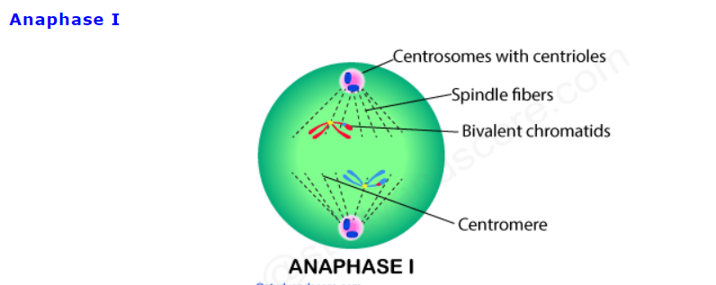

Slide 25
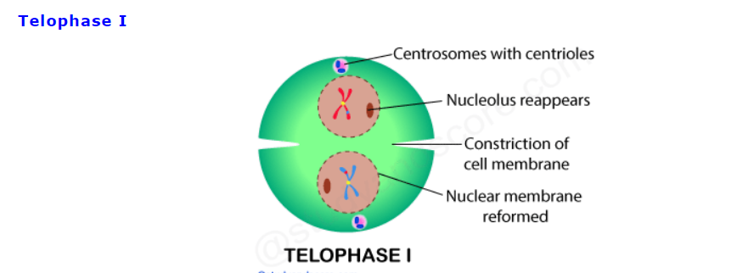
4) Telophase 1:
In this meiosis phase, the decondensation of chromosomes occurs., later the chromosomes are completely separated and the nuclear envelope forms.
Cytokinesis is the process where the plasma membrane is divided into two daughter cells.

Slide 26
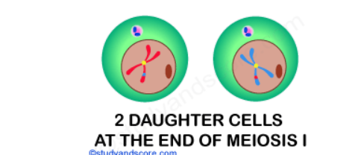
5) Cytokinesis 1
The cell membrane constricts and two daughter cells are formed.
These daughter cells have chromosome consisting of one of its original chromatids and the other has the mixture of segments from its own and a segment of chromatid from its homologue.
The formation of nuclear membrane and the nucleus is completed at this stage.
And finally the daughter cells are ready to proceed to the next stare, Meiosis II.

Slide 27
Interphase II or Interkinesis
The two cells or nuclei thus formed pass through a short stage called interphase-II.
It is the resting phase between meiosis-I and meiosis-II.
It is either very short or may be absent
No DNA synthesis occurs.

Slide 28
MEIOSIS II
The second meiotic division is very much similar to mitosis. But the only difference is that the DNA does not duplicate whereas the centromeres do duplicate.
Meiosis II is also called as the mitotic or equational phase.
1. Prophase II
The events of prophase II are similar to mitotic prophase.
Chromatids have widely separated arms.
Nucleolus and nuclear membrane disappear.
Spindle fibres are formed at each pole.
2. Metaphase II
Chromosomes move to the centre of the equatorial plane.
They get attached to spindle fibres centromere.
The centromeres divide.

Slide 29
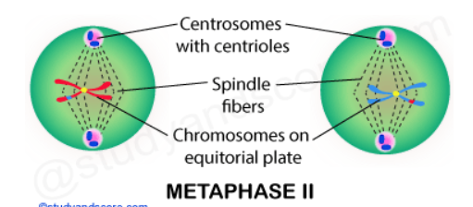

Slide 30
3. Anaphase II
The sister chromatids separate from one another.
The sister chromatids are pulled to opposite poles due to contraction of spindle fibres.
The chromatids after reaching the poles are called chromosomes.
4. Telophase II
Reconstitution of nuclei takes place
The chromosomes begin to uncoil and become thin.
Nucleolus and nuclear membrane reappear at each pole.

Slide 31
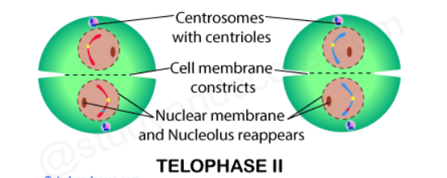

Slide 32
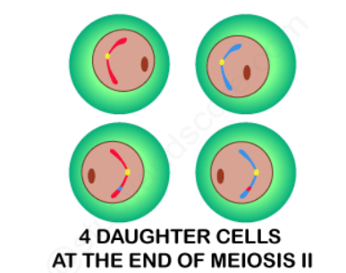
5. Cytokinesis II
Cytokinesis of the daughter cells cause the formation of two cells, in other words from the two daughter cells of the first meiotic division, four cells are produced each with haploid set of chromosomes.
In animal cells, cytokinesis occurs by furrow formation or depression.

Slide 33
SIGNIFICANCE OF MEIOSIS
Essential for sexual reproduction in higher animals and plants.
Meiosis helps in the formation haploid gametes and spores for sexual reproduction.
Crossing over occurring brings genetic variations in offspring which helps in evolution of organisms.

Slide 35
References
Verma, P. S., & Agrawal, V. K. (2006). Cell Biology, Genetics, Molecular Biology, Evolution & Ecology (1 ed.). S .Chand and company Ltd.
Std 11 NCERT book of biology
Web sources

