Slide 1
Nucleus
B.Sc Microbiology
Sem-3 Cell biology

Slide 2
What is Nucleus?
The cell nucleus​ is a membrane-bound structure that contains the cell’s hereditary information and controls the cell’s growth and reproduction.
It is first described by Robert Brown as the cell organelle.
The largest and most prominent organelle in the cell, the nucleus, accounts for almost 10% of the volume of the entire cell.
In mammalian cells, the average diameter of the nucleus is approximately 6 µm in size.
Mostly the shape of the nucleus is found to be either spherical or oblong.

Slide 3
1) Nuclear Envelope and Nuclear Pores
It is of the double- membrane and surrounds the nucleus.
Outer and inner membrane are present in it. The outer membrane of the nucleus is continuous with the ER ( Endoplasmic reticulum ). On its outer surface, there is the presence of many ribosomes.
Perinuclear space is present between the membranes. The perinuclear space has a thickness of 20 to 40 nm.
It is impermeable to large molecules like proteins and RNA.
Small molecules and ions can move freely.
Nuclear pores are present in the nuclear envelope. These pores are the small gaps present in the envelope.
Chemical composition: lipo-proteinous
The function of the nuclear envelope
It gives the shape to the nucleus.
It protects the internal constituents of the nucleus.
It controls and regulates the movement of the substances which enter and exits the nucleus.

Slide 4
2) Nuclear Lamina
They are meshwork of protein filaments organized in a net-like fashion that line below the inner nuclear membrane.
The proteins that make up the nuclear lamina are known as lamins, which are intermediate filament proteins.
It is also called a nuclear scaffold.
With the use of non-ionic detergents, nucleases, and high salt buffers, extraction of the nuclear matrix from the cell’s nucleus is possible.
Functions:-
Supports the nuclear envelope, maintaining the overall shape and structure of the nucleus.

Slide 5
3) Chromatin
Inside the nucleus, there is the presence of chromatins. During the cell division, it is condensed in the chromosome.
It is dense in structure and is thread-like. It consists of proteins and DNA.
Chromosome remains in the form of chromatin fibers at the interphase stage of cell division.
They are differentiated into two distinct regions as heterochromatin and euchromatin.
based on functions, The heterochromatin is a functionally inactive form of chromatin, found near the nuclear envelope. On the contrary, euchromatin is a mild, less condensed form that is in functionally active state.
An organized chromatin material that is highly condensed and paired is known as the chromosome.
Functions:-
Contains hereditary information and instructions necessary for controlling processes such as metabolism, cell growth, and cell division
Helps in gene expression where DNA molecules make an RNA copy, a process called transcription which is later converted to proteins by a process called translation.

Slide 6
4) Nucleoplasm
Nucleoplasm is a clear and transparent, gelatinous substance. It is also known as the karyoplasm.
It surrounds the nucleolus and chromosomes.
It consists of water, minerals, sugar, protein, nucleotides, enzymes, and RNA.
Nucleoplasm is a semifluid substance.
Function of nucleoplasm:-
It forms the spindle proteins which aids in cell division.
It protects the contents of the nucleus.
It provides the medium by which the enzymes and nucleotides get transported throughout the nucleus.
RNA and DNA are synthesized in it.
Nucleolus and chromatin reticulum are held by nucleoplasm.
It provides support by acting as the nuclear skeleton.

Slide 7
5) Nucleolus
It looks like a dark spot within the nucleus and is a dense, membrane-less structure composed of RNA and proteins along with granules and fibers that remain attached to chromatin.
During the cell division, it disappears in the late prophase. In the Telophase stage, it reappears.
The structure of the nucleolus consists of three main regions. They are :
Fibrillar centers: In the form of partly condensed chromatin, ribosomal RiboNucleic Acids (rRNA) genes are present.
Fibrillar component: It surrounds the fibrillar centers where RNA molecules are present.
Granular regions: It consists of the mature ribosomal precursor particles. These are the outermost regions.
In the nucleus, the nucleolus may be present 1 to 4 in number.
Functions of the Nucleolus:-
RNA is synthesized and stored in it.
Sub-units of ribosomes are formed.
During the cell division, it forms the spindle.

Slide 8
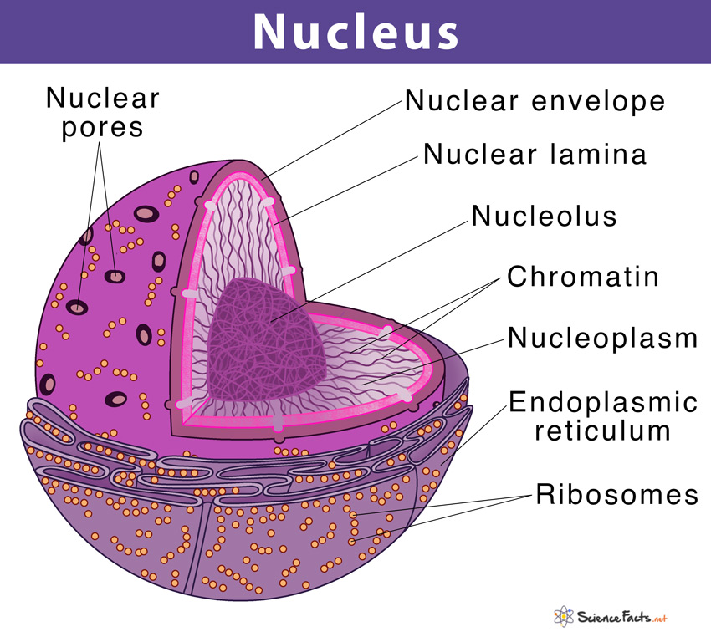

Slide 9
Functions of the Nucleus
1. Storing genetic material
Genetic material like DNA is stored in the nucleus.
It is the cellular hereditary material.
The information which is encoded in the DNA is passed to the offsprings from the parents.
2. DNA replication
Replication is the process of copying the parental DNA.
It occurs in the cell nucleus.
It takes place in the S phase of the interphase of the cell cycle.
3. Transcription
It provides the site for genetic transcription.
It allows the level of gene regulation which are not available to prokaryotes. It consists of a variety of proteins.
Different proteins involved in it are helicases, RNA polymerases, topoisomerases, etc.

Slide 10
4. Other functions
Coordinates and regulates cellular activities like cell division, protein synthesis, and growth.
The formation of ribosomes occurs in the nucleolus.
Through the nuclear pores only selective transportation is allowed.
Organic evolution: It involves variation and can induce genetic change.
Nucleolus stores the proteins and RNA.
In the nucleus, during the cell division, chromatins are arranged into chromosomes.

Slide 11
References
Verma, P. S., & Agrawal, V. K. (2006). Cell Biology, Genetics, Molecular Biology, Evolution & Ecology (1 ed.). S .Chand and company Ltd.
Std 11 NCERT book of biology
https://microbenotes.com/nucleus-structure-and-functions/
Web Sources

