Slide 1
THE HNSB. LTD. SCIENCE COLLEGE, HIMATNAGAR
PAPER CHNN-603 (Medicinal Chemistry)
UNIT: 1 Drug Design & QSAR
TOPIC: QADD
Presented by
Dr. Z. M. Gadhawala

Slide 2
CADD (Computer Aided Drug Design)
BENEFITS: Less time, less man power, less cost
Uses computational chemistry (Computer) to discover, develop & analysis of any drugs & related biological active molecules.
Disease: Know about reasons of disease.

Slide 3
Target Identification
Receptor Identification
It is a process to find protein (e.g. receptor) or gene associated with a disease with which a potential drugs interact – the so call target.
That means from proteins, genes, RNA etc targets, first identify that which target is favorable for drugs binding.
e.g. In diabetes: We take food Carbohydrates INS gene
not break down
So it is deposited in our body Sugar molecules Insulin
Disease | Receptor (Over 3 million pain receptors found in our body)
Diabetes | INS gene
Corona | ACE 2 (enzyme 2) (Angiotensin converting enzyme 2)
Fever | EP3 (Prostaglandin)
Alzheimer | G- protein coupled receptors (GPCRs)
Hypercalcaemia | CaSR (Calcium Sensing Receptor)

Slide 4
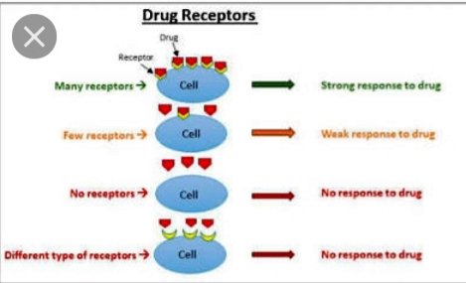

Slide 5
Hit Identification (HitID)
It is first committed step for a successful drug discovery project. In this process, the right small molecules (hits), which binding to the target & modifying its function are identified.
Structure Based Drug Design
(SBDD)
Protein
Ligand
Ligand Based Drug Design
(LBDD)
Protein
Ligand
De Novo Design
(Virtual Screening)
Protein
Ligand
Library Design
Protein
Ligand

Slide 7
Hit to Lead
Once a promising drug target has been identified, researchers aim to identify potential molecules that can interact with the target (receptor) & produce desired biological effects.
Lead compounds are selected from a collection of Hits by bio-assay screening on the base of physicochemical, in vivo, in vitro and ADME(absorption, distribution, metabolism & excretion) properties.
Lead Optimization
Finding lead which have less binding energy but more stability.
Means the synthetic refinement of a candidate drug from its crude or original state and is safer, useful or more marketable.
Lead compound optimize on the base of bioassay e.g. In vivo & in vitro activities as well as QSAR & QSPR studies.
In Vivo – In Body
In Vitro – In Laboratory

Slide 8
Pre Clinical Study
1.5 – 2 Years
This study is done on animals and effect as well as side effect of drugs are check.

Slide 9
Clinical Study
5 – 7 Years
Phase- I (20-80 patients)
Checking of side effects in healthy volunteers. Tolerability
E.g. Paracetamol: Fever removed but the side effect is low, blood pressure, fast heartbeat.
Phase- II (small-scale trials of 100-500 patients)
Small-scale trials in patients to assess efficiency and dosage.
E.g. Diabetes drug---- in small dose---- patients----- check effect & side effect.
Phase- III (500-3000 patients)
(Large scale controlled clinical trials)
Slowly slowly increase the dose and fix a dose which will be launched in the market. This dose is known as a controlled dose.
Phase- IV
(Post-marketing surveillance)
No fixed time duration
Apply on multiple patients by doctors and check for any side effects.

Slide 10
Drug Approved
After successful clinical trials drugs are administered for approval in approval in FDA .
The FDA gatekeeper for access to new drugs.
MARKET

