Slide 1
The HNSB. Ltd. Science College Himatnagar
PAPER CHNN-603 (Medicinal Chemistry)
UNIT: 1 Drug Design & QSAR
TOPIC: Pharmacopeia
Presented By: Dr. Z. M. Gadhawala

Slide 2
P
1.Pharmacopeia
2.Formulary
3.Drugs Compendia
4.Indian Pharmacopeia (@ Indian National Formulary, Indian Pharmaceutical Index)
5.British Pharmacopeia (British National Formulary, British Pharmaceutical Index)
6.United State Pharmacopeia(National Formulary)
7.International Pharmacopeia
8.European Pharmacopeia
9.Japanese Pharmacopeia

Slide 11
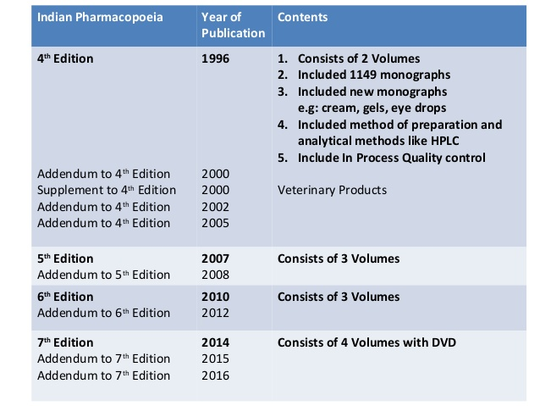

Slide 14
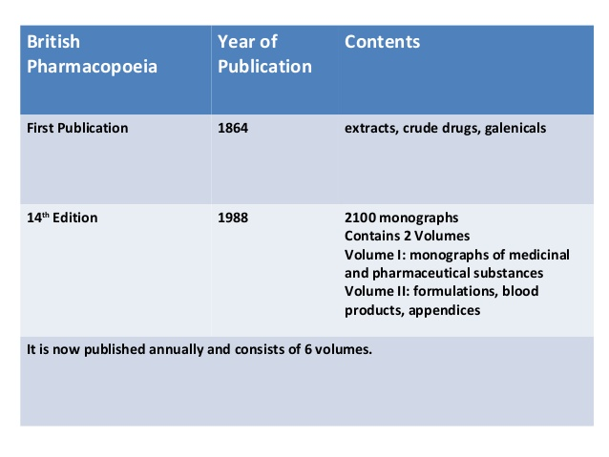

Slide 22
THANK YOU

