Slide 1
25/9/2023 At M.G.Panchal Science College, Pilvai
THE HNSB. LTD. SCIENCE COLLEGE, HIMATNAGAR
PAPER CHNN-603 (Medicinal Chemistry)
UNIT: 1 Drug Design & QSAR
The HNSB. Ltd. Science College, Himatnagar
Dr.Z.M.Gadhawala M.Sc., Ph.D. FICCE

Slide 2
First we should know that what is disease?
We are familiar that normal human body temperature is 37±1ºC but in some situation it is deviate. It is known as disease.
MEDICINE: Any material which is cure a disease is called medicine.
PHARMACEUTICAL: Process to preparation medicine take placed is called pharmaceutical.
Drug: Row material at industries is known as drug.
What is difference between Drug and Medicine?
DRUG
A drug is a substance, which also cures the disease but is habit forming, cause addition, and has serious side effects. Eg. Aspirine
MEDICINE
Medicine is a chemical substance, which cures the disease, is safe to use, has negligible toxicity, and does not cause any addiction. Eg. Disprine

Slide 6
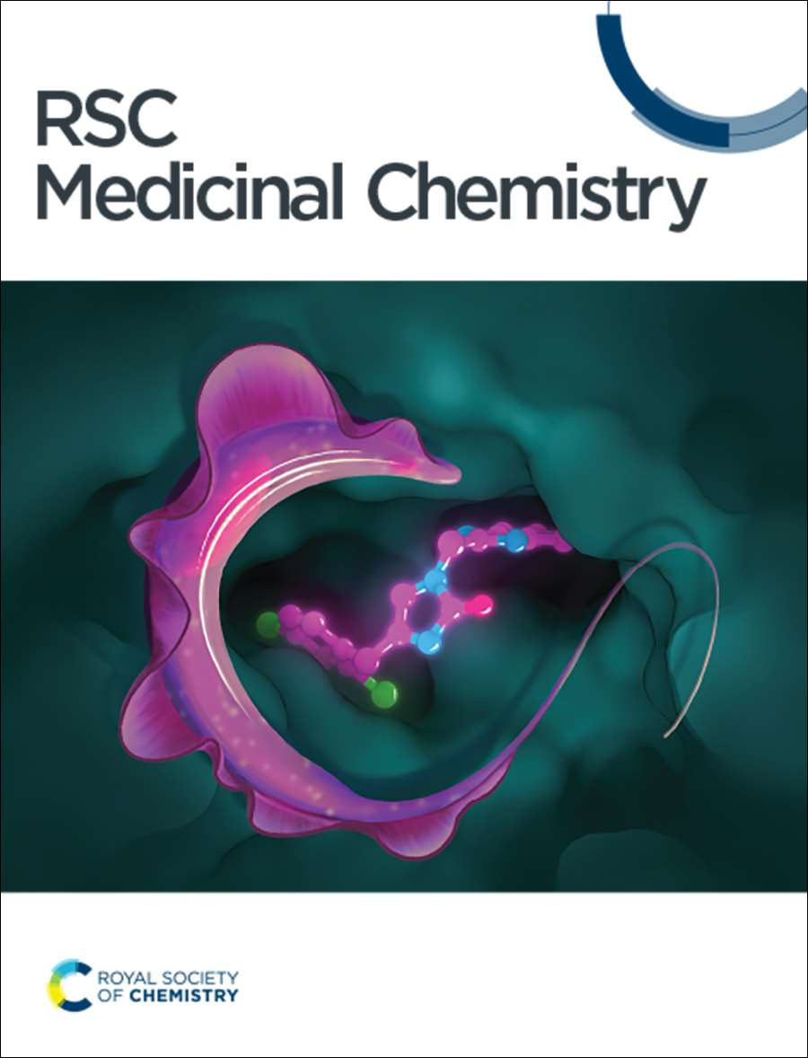
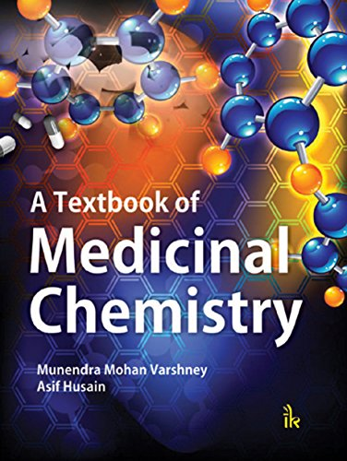
Literature
Of
Medicinal Chemistry

Slide 7
We can divided literature of medicinal chemistry in the following category:
Standard Textbook
Reference book
Journal
Review (Report)
Abstract
Treatise (Granth)
Encyclopedia
Standard Data book
Pharmacopeias
Patents

Slide 8
Standard Textbook
A textbook is a manual of instruction in any branch of study.
Textbook are produced according to their demands of education institutions.
Now a days most textbook are not published in printed format, many are now available as online electronic books.
Standard textbook cover general aspects.
Advanced level aspects may or may not given.
Price of this book is low cost.
we can get it very easily.
E.g. –Jerry March ( Too much references)
-Morison Boyd (Does not mention any references)
-Carey & Sundberg
-I. L. FINAR (Gives general references)

Slide 9
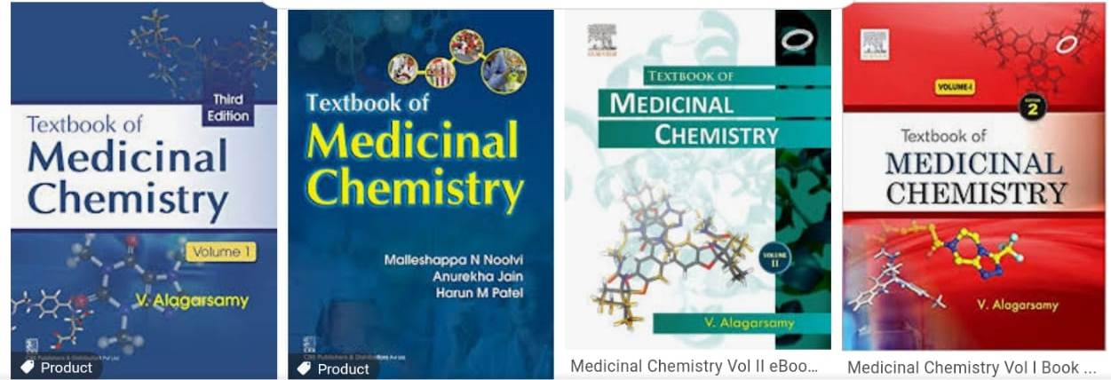

Slide 10
Reference Book
A book which have only specific topic known as reference book.
Reference book are sources you should reference to for a broad, factual overview on variety verity of topics.
It’s cover detailed aspect of a limited area.
High Cost.
Not issued in library.
E.g. –Burger’s Medicinal Chemistry

Slide 11
Journals
Journal is periodicals.
This is original literature.
Journal is primary source of research.
Some parts of journals comes in chemical abstracts.

Slide 12
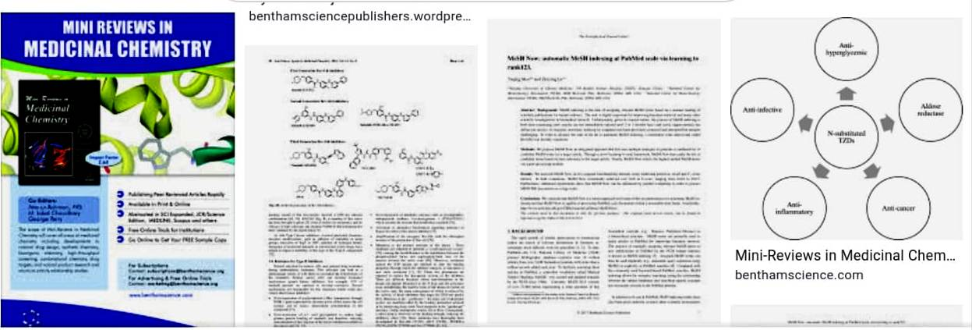
Reviews
Work of research person is called reviews.
It is also identical to thesis.
e.g. –For developing anti AIDs drugs you have to check all journals.

Slide 13
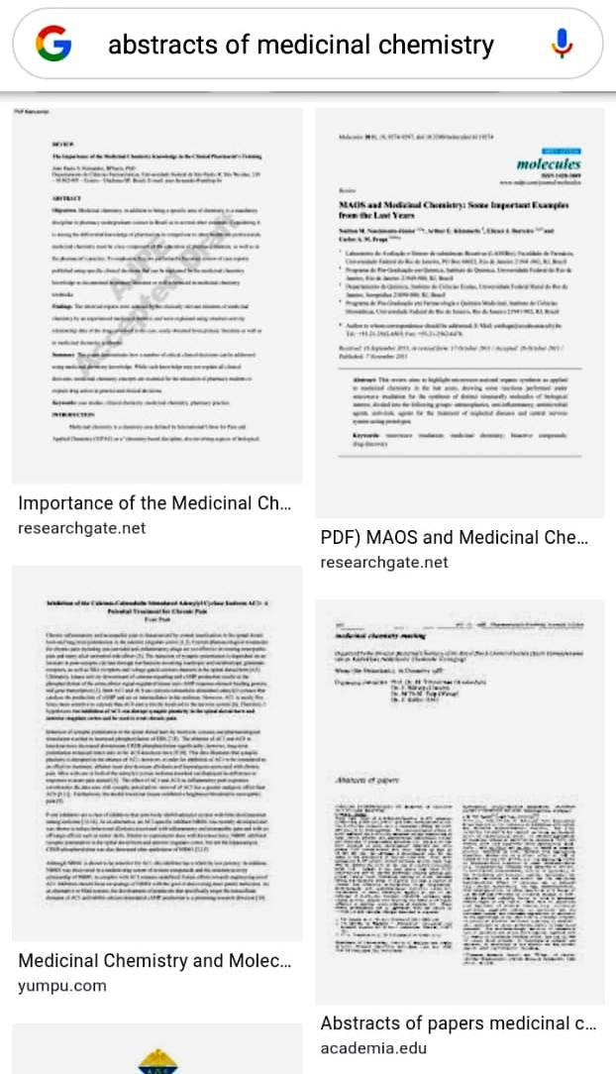
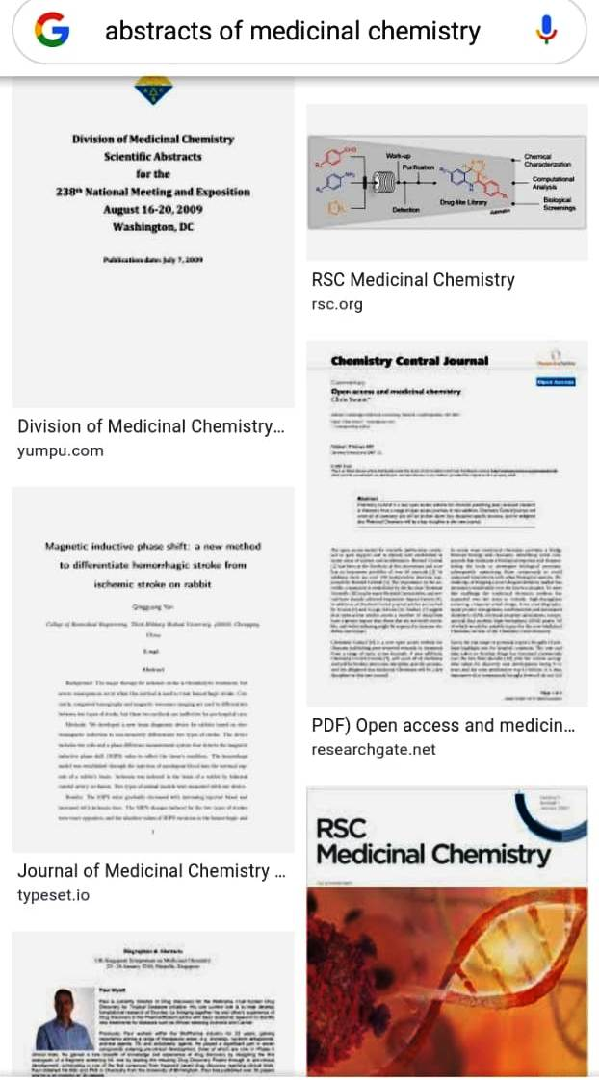
Abstract:
Written summery of an article or book.
An abstract is brief summery of a research article, thesis, review, conference or any depth analysis of particular subject.

Slide 14
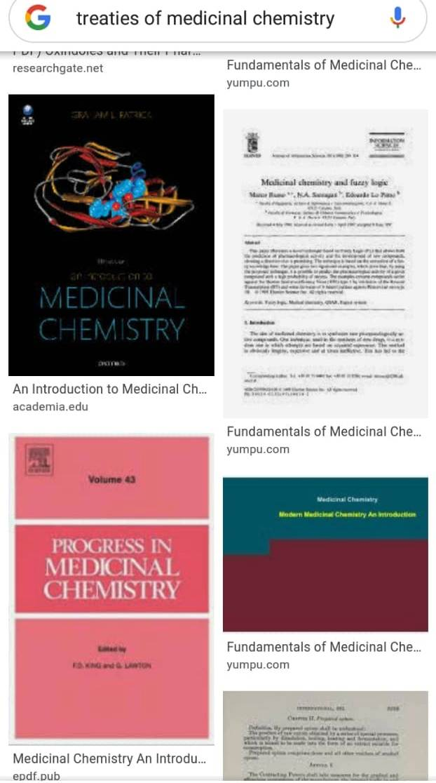
Treatise(Granth)
Treatise is occurring in a broad area.
E.g. –There are 40 volumes of analytical chemistry book.
-Thus broad area (40Volumes) is also called Treatise.

Slide 15
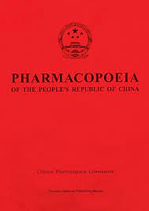
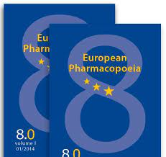
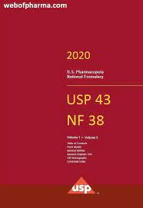
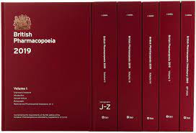
Standard Data book
Doctors are always use this kind of book.
-E.g.-Pharmaceutical Codex.
Pharmacopeias :

Slide 16
Encyclopedia
A book or set of books giving information on many aspects of one subject & typically arranged alphabetically.
-Encyclopedia cover very very broad subject of area.
-There are number of volume available.
E.g.-Encyclopedia of science & technology.

Slide 17
Pharmacopeia
It is a book containing directions for the identification of medicines and published by the authority of government or a medical or pharmaceutical society. It is a reference book for pharmaceutical drugs specifications. In the Pharmacopeia description of drugs are given which is called monographs.
eg. Indian Pharmacopeia (IP)
British Pharmacopeia (BP)
United State Pharmacopeia (USP)

Slide 18
DRUG NOMENCLATURE

Slide 19
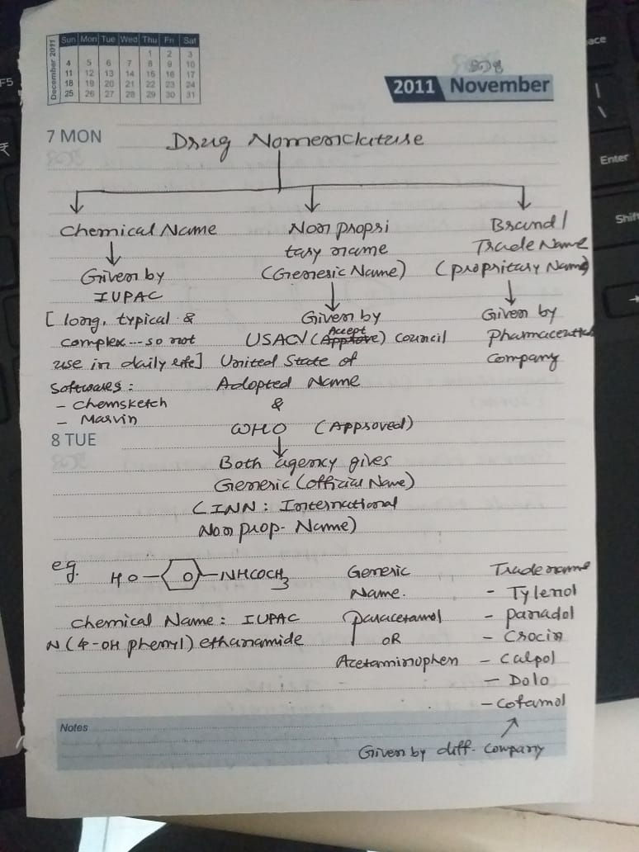

Slide 20
Naming of Organic Medicinal Compounds (Nomenclature)
In 1957 the International Union of Pure and Applied Chemistry (IUPAC) evolved a scheme for giving the systematic names of organic compound on the basis of structure. This is known as IUPAC system.
Every drugs gives minimum three or more names get by its manufactures.
Chemical Name
General Name (Generic Name)
Trade Name (Non-proprietary Name)

Slide 21
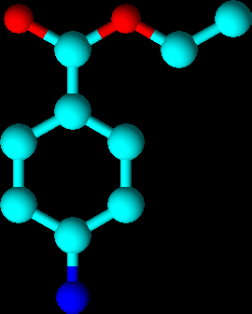
1) Chemical Name
The chemical name is the first name and describes the chemical structure of the drugs.
The chemical names are scientific name based on molecular structure of drug.
e.g. Chemical name of local anesthetic a benzocain is ethyl 4-amino benzoate.
There are various system of chemical manufacture but out of these IUPAC names are typically long & too complexive. So to avoid these problem many pharmaceutical company uses the code & it is very small so we can identify the drug.
e.g. CDP 70 is UCB’s company code for cimzia. (For Arthritis)

Slide 22
1) Chemical Name
According to IUPAC the various functional groups are named as follow:
-CH3CONH- | Acetamido
-CH3COO- | Acetoxy
-CH3CO- | Acetyl
-CH2=CHCO- | Aeryloyl
-CH2=CHCH2- | Allyl
-C6H5NH- | Aniline
-C6H5CONH- | Benzamido
-(C6H5)2CH- | Benzydryl
-Ph2-N- | Benzydiyl
-Ph-CH2 | Benzyl
-(Ph2)CO- | Benzoyl
-NH2-CH2CO- | Glycol
-OH | Hydroxy
-NO2- | Nitro
=O | Oxo
-CH2OH | Hydroxymethyl
-I | Iodo
-(CH3)2CH- | Isopropyl
-CH3O | Methoxy
-CH3 | Methyl
-Cl | Chloro
-CN- | Cyno
-RCHO- | Formyl
-C6H5O- | Phenoxy
-C6H5- | Phenyl
-CH3CH2CH2O- | Propoxy

Slide 23
2) General Name ( Generic Name)
Drug’s general name is used in maximum and its approved by council of pharmacy and chemistry of medical association, it’s called Approved name.
As we know that IUPAC names are too long & complexive. So, to avoid this problem many companies become active & establish the “Relevant national regulatory agency it is just like FDA.
There are many agencies such as USAN(United State Adopted Name), JAN(Japanese Accepted Name), BAN(British Approved Name), AAN(Australian Approved Name) which are accompanied to WHO.
Generic names are as follows:
Stem | Drug Class | Example
-Vir | Antiviral drugs | Aciclovir
-Cillin | Antibiotic | Penicillin
-Oxetine | Antidepressant | Reboxetine
-Prazole | Proton pump inhibitor | Omeprazole

Slide 24
3) Trade Name (Non-proprietary Name)
For any drug, after development, testing & acceptance, the pharma company then gives the drug’s trade name.
The term trade name is standard term in the pharmaceutical industry for brand name.
Now a drugs non-proprietary name are given by USAN “United States Adopted Name”.
It is general common name identification of drugs and it is not depend on it’s manufactures. It is decided USAN(US) pharmacopeia.
Non-proprietary name usually the official name of the drug.
The trade name of an anxiety drug is diazopam having the trade name as vallien.
Single drug may have different trade name.

Slide 25
3) Trade Name (proprietary Name)
Chemical Name | Generic Name | Trade Name
N-acetyl p-amino phenol | Paracetamol | Tylenol
2-acetoxy benzoic acid | Acetyl salicylic acid | Aspirin

Slide 26
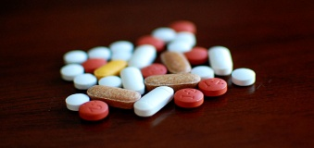
Drug Design
Drug design is the approach of finding drugs by design, based on their biological targets.
Drug
Synthesis
Drug
Screening
(Testing)
Clinical Study
Pre-clinical Study
Testing on Animal
Phase- I
FDA
Registration
Phase- II
Phase- III
Market
Phase- IV
IND

Slide 27
Drug Design
First for designing a drug, we have to check the material, then that material goes for synthesis.
Pre-clinical Study
Synthesis & Purification
In this step, we check some properties of drug material like spectroscopic analysis, %purity by M.P.,TLC, HPLC, GC etc.
Testing
Pharmacokinetics:
In this parameter, we check it’s absorption, distribution, metabolism excretion & half-life (expiry date).
Pharmacodynamics:
In this parameter we check mechanism of action or therapeutic effect.
Toxicity including carcinogenicity:
In this parameter we check mutagenicity(permanent change in genes), docking study, teratogenicity(Fetal abnormalities) & side effect of drugs.
Effecting study on animals
The main objective of pre-clinical studies is to assertion the safety of the newly developed drug, It is never permitted to test on human body, unless supported by a confirmed data about pharmacology & toxicity of molecule, which is based on animal studies.
Then when approval of this it came on IND(investigational New Drugs) committee then FDA and IRB (Institutional Review Board).

Slide 28
Drug Design
Clinical Study
This stage involves actual testing of drug in human volunteers.
Before, the start of this stage, the innovator should file an application namely “Investigational New Drug (IND)” as the FDA “Food & Drug Department” approves the preclinical data, then innovator can proceed for clinical studies.
This stage consists of,
Phase-I: Efficiency study on healthy volunteer about (20-80 people) for 1 year, result 70%.
Phase-II: Studied on small population about (100-300 people) with target disease for 2- years, result 33%.
Phase-III: Studies are extensive on large scale about (1000-3000 people) for 3 years, results 25-30%.
Phase-IV: In this studies are carried out after the drug has been launched into market.
The company continuous monitoring on the drug.
Then approval of NDA & gave the regulatory reviews. Then meeting of FDA & drug sponsors mate. After 60 days drug is in market.
If any serious adverse reaction is observed after the drug launched, the company may withdraw drug from market.

