Slide 1
THE H.N.S.B. LTD SCIENCE COLLEGE HMT
CLASS SEMINAR
SEM:-2
YEAR:-2010-2011
PAPER NO :-CHN-502
UNIT-1 (FREE RADICAL REACTION)
TOPIC:- FORMATION OF CYCLIC ETHER & COUPLING OF ALKYNES
Presented By : Dr.Z.M.Gadhawala

Slide 2
FORMATION OF CYCLIC ETHERS
Alcohols having a δ hydrogen undergo cyclisation with lead tetra acetate to give tetra hydro furans in high yields. Little or no four and six-membered cyclic ethers (oxetanes and tetra hydro pyran respectively) are obtained in the case of alcohols having a Ƴ or ɛ hydrogen.

Slide 3
The reaction has also been carried out with a mixture of halogen (Br2 or I2)and a salt or oxide of silver or mercury (especially Hgo or AgOAc).

Slide 4
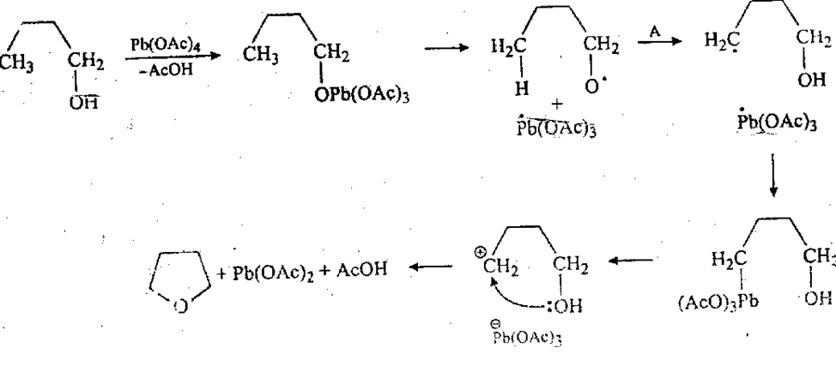
The following mechanism has been proposed for the cyclisation with lead tetra acetate. The step marked A is a 1,5 internal hydrogen abstraction which is greatly favored over l,4 or 1,6 abstractions.

Slide 5
COUPLING OF ALKYNES
Terminal alkynes can be coupled by heating with stoichiometric amounts of cupric salts in pyridine or similar base.

Slide 6
This reaction produces symmetrical dynes in high yields and is called Eglinton reaction.
Another common procedure is use of catalytic amount of cuprous salts in the presence of ammonia or ammonium chloride.
Atmospheric oxygen or some other oxidising agent, e .g.. permanganate or H2O2 is require in this method which is called Glaser reaction. Unsymmetrical diynes can be prepared by-Cadiot-Chodkiewicz coupling (mechanism is not fully understood)

Slide 7
The mechanism of 'Eglinton and Glaser reactions is outlined below

Slide 8
THANKS

