Slide 1

THE HNSB. LTD. SCIENCE COLLEGE, HIMATNAGAR
PAPER: CHN 701(O)
UNIT:1- (B) CARBOHYDRATES
PREPARED AND PRESENTED BY: DR. Z.M. GADHAWALA

Slide 2
SYLLABUS
Type of Naturally occurring Sugars, Deoxy sugars, Amino sugars. General method of structure and ring size determination with reference to Starch and Cellulose
Photosynthesis of Carbohydrates.
Purine & Nucleic Acid :-
Chemistry of Uric Acid, Adenine, Caffeine
Structure of Nucleotides, Nucleosides, DNA, RNA and Conformations, Protein synthesis, Perbiotic Chemistry.

Slide 3
Reference Books
Organic Natural Products by O.P. Agrawal

Slide 4
COs
To enable students about the knowledge of amino sugar, deoxy sugar, polysaccharide like cellulose and starch, photosynthesis of carbohydrates,

Slide 5
Definition of Carbohydrates
M.F.: Cx (H2O)y
Having functional group like hydroxyl, aldehyde or ketone = carbohydrate
H:O = 2:1

Slide 6
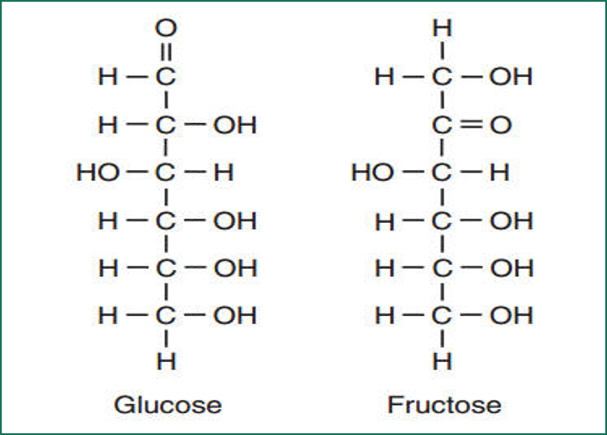
Examples of carbohydrates:(Mono Saccharide)
Triose: C₃H₆O₃
Tetrose: C₄H₈O₄
Pentose: C₅H₁₀O₅
Hexose: C₆H₁₂O₆

Slide 7
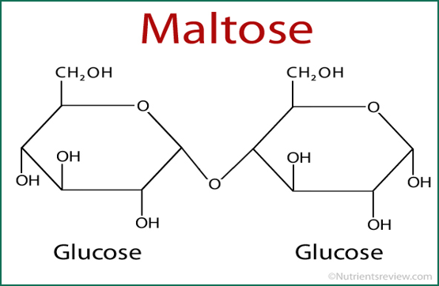
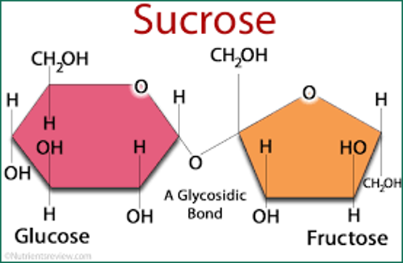
Disaccharide
Sucrose:
Maltose:

Slide 8
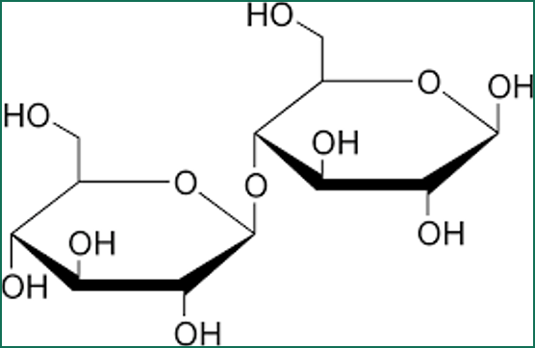
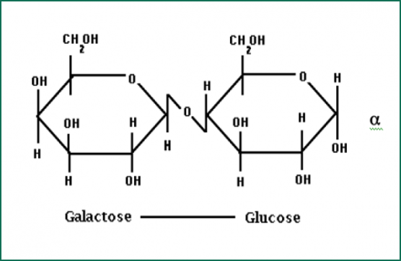
Lactose:
Cellobiose:

Slide 9
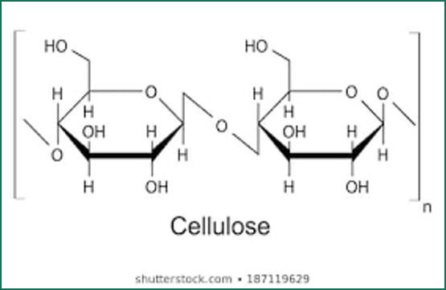
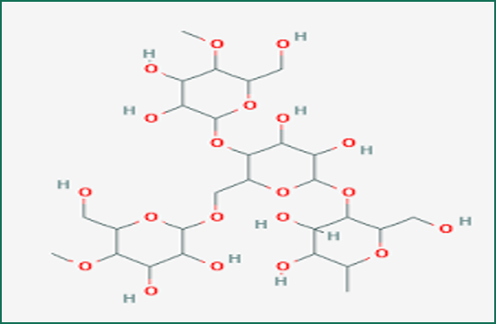
Polysaccharide
Cellulose:
Starch:

Slide 10
CELLULOSE :
Cellulose is a chief compound of wood & plants fibers
Cotton is a 100% pure Cellulose.
It is insoluble in water & tasteless.
It is non reducing carbohydrate.
The Cell wall of plants cell is made from Cellulose.
Like body skeletal of man, the structure of plant is made from Cellulose.
USES : It is useful for making of different types of clothes, chemicals, papers, film and rayon

Slide 11
Constitution of Cellulose:
M.F.:[C6H10O5]n
Present groups:
⸫ No. of D(+) Glucose unit = 100 to 200
⸫Polysaccharide
M.W. = 20000 to 40000 gm/mole

Slide 12
Cellulose
⸫3 –OH present in each glucose unit
Acetylation
Triacetoxy cellulose
Methylation
Trimethoxy cellulose
Nitration
Trinitro Cellulose

Slide 13
Cellulose Methylated cellulose
Glucose Methylated Glucose
Methylation
Hydrolysis
2,3,6-tri methoxy D(+) Glucose
+
2,3,4,6-tetra methoxy D(+) Glucose
Hydrolysis
Methylation

Slide 14
Glucose units joint C1-C4 linkage
Glucose units Pyranose cycle
on C2,C3 & C6 3 –OH
2,3,4,6-tetra methoxy D(+) Glucose C1 –OH
&
2,3,6-tri methoxy D(+) Glucose C4 –OH

Slide 15
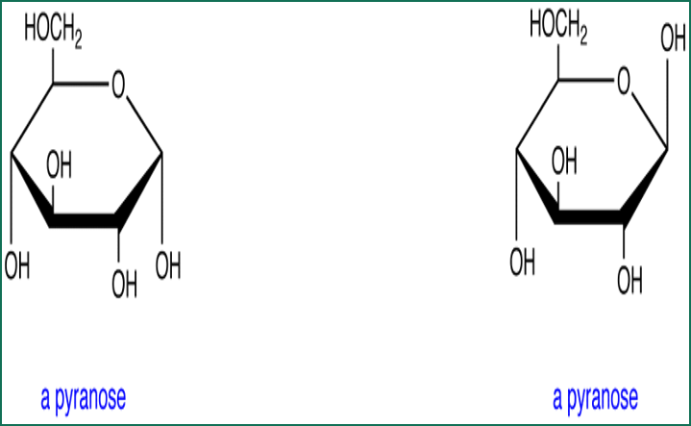

Slide 16
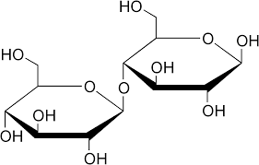
⸫ Cellulose have no. of Cellobiose units

Slide 17
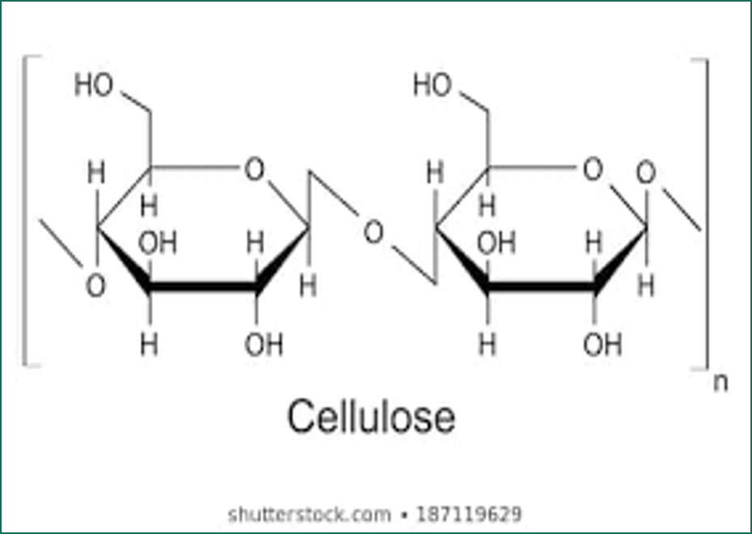
S.F. of Cellulose

Slide 18
Starch
Sources : From maize, beat, rice, wheat, and potato's tumor
It is insoluble in cold water. Its make a paste with hot water.
Uses : It is used as a sizing material in paper industries, Finishing agent in textile industries, and Calico printing.
It is also used in laundries for finishing of clothes.
It is also used for manufacture of glucose, alcohol, dextrin, & explosives.
It is also used as a indicator in Kinetic titration.
Starch contain 20 % water soluble fraction called Amylose & 80 % water insoluble fraction called Amylopectin.

Slide 19
Constitution of Starch
M.F.:[C₆H₁₀O₅]_{n}
Present groups:
⸫ No. of D(+) Glucose unit = 300 to 350
⸫Polysaccharide
M.W. = 15000 to 60000 gm/mole

Slide 21
Structure of Maltose
M.F. : C₁₂H₂₂O₁₁
Present Groups:
Maltose phenyl hydrazone
Maltose
Malt bionic acid
Phenyl Hydrazine
Br₂ Water

Slide 22
Maltose Octa methoxy Maltose
Glucose Methylated Glucose
Methylation
Hydrolysis
2,3,6-tri methoxy D(+) Glucose
+
2,3,4,6-tetra methoxy D(+) Glucose
Hydrolysis
Methylation

Slide 23
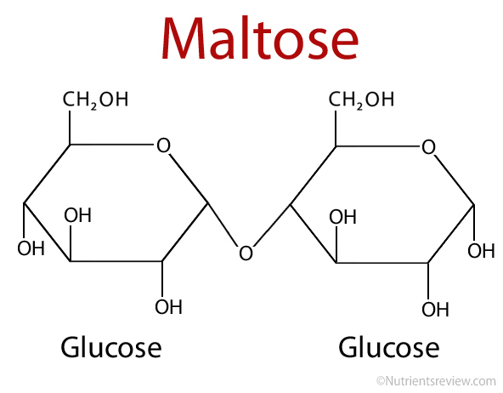
Structure of maltose

Slide 24
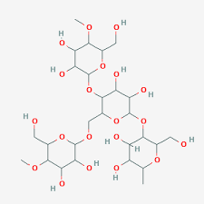
Structure of Starch

Slide 25
General Information of Alpha & Beta Amylose
Starch contain 20 % alpha Amylose & 80 % beta Amylose.
When we add n Butanol in hot solution of Starch and allow to stand at room temperature and filter it then we will get PPTs of alpha Amylose and filtrate contain beta Amylose.
I2 is added in the hot solution of alpha Amylose then it gives blue color and I2 is added in the hot solution of beta Amylose then it gives violate color.
Enzymatic hydrolysis of alpha Amylose gives Maltose While enzymatic hydrolysis of beta Amylose gives 62 % Maltose and 38 % Amylopectin.
The structure of alpha Amylose has linear structure and beta Amylose has branched structure.

Slide 26
Constitution of α- Amylose
M.F. :[C₆H₁₀O₅]_{n}
Hydrolysis: Acidic & Enzymatic
M.W. = 50000 gm/mole
Acidic Hydrolysis indicates that 300 – 350 Glucose units are present.
Enzymatic Hydrolysis indicates that in alpha Amylose no. of Maltose units having glucose are present.
Maltose is 4- O- D- GlucoPyranose
@ Pyranose Cycle & C1-C4 linkages

Slide 27
Methylation: Reaction :
α- Amylose Methylated Amylose
(CH3)2SO4/NaOH
dil HCl/H-OH
+
Methylation
2,3,4,6-tetra methoxy D(+) Glucose
2,3,6-tri methoxy D(+) Glucose
@ Pyranose Cycle
@ C1-C4 linkages
@ Linear structure

Slide 28
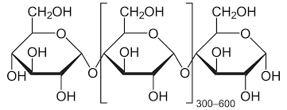
Structure of α- Amylose

Slide 29
Constitution of ß- Amylose (Amylopectin)
M.F. :[C₆H₁₀O₅]_{n}
Hydrolysis:
M.W. = 50000 to 1000000 gm/mole
Average M.W = 550000 gm/mole
@ 3000 Glucose units are present.
Oxidation:
Oxidation with HIO4 it gives formic acid. It is possible when 24-27 D(+) Glucose units are present in linear chain & then after one branch of non reducing group is present.

Slide 30
Methylation: Reaction :
Amylopectin Methylated Amylopectin
Pyranose Cycle
Branched structure
120 branches +
Methylation
Hydrolysis
2,3,6- tri methoxy + D(+) Glucose
2,3-dimethoxy D(+) Glucose
2,3,4,6- tetra methoxy D(+) Glucose

Slide 31
Enzymatic Hydrolysis : Diastase
Amylopectin 1,6 alpha linked di Glucose (32%) + Maltose (62%)
In Maltose Glucose units joint with each other in linear chain (main chain) with C1-C4 linkages and in Iso maltose Glucose units joint with each other with C1-C6 linkages(branches chain)

Slide 32
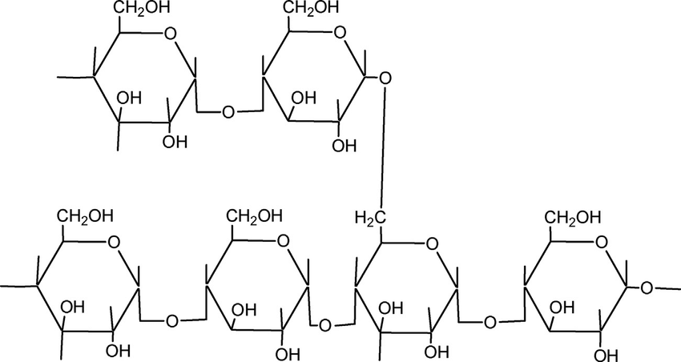
Structure of Amylopectin

