Slide 1
M.Sc SEM- 2 CHNN : 502 UNIT:
AROMATIC ELECTROPHILIC SUBSTITUTION REACTIONS
Dr. Z.M.Gadhawala
Associate Professor
M.Sc,Ph.D, FICCE

Slide 2
Learning Outcomes
Introduction: Electrophilic Aromatic Substitution
Arenium Ion Mechanism
Some Aromatic Electrophilic Substitution Reactions Viz. Nitration, Sulphonation, Halogenation, Friedel- Crafts Reaction
Orientation & Reactivity in Mono Substituted Benzene
IPSO Attack
Vilsmeier Haack Reaction
Gattermann Koch Reaction
Diazonium Coupling Reaction
Reference from e-PG Pathshala, Wikipedia, Vedantu e-learning

Slide 3
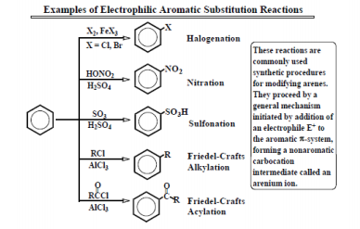
Electrophilic Aromatic Substitution : Electrophilic aromatic substitution is an organic reaction in which an atom that is attached to an aromatic system (usually hydrogen) is replaced by an electrophile. e.g. aromatic nitration, aromatic halogenation, aromatic sulfonation, and alkylation and acylation (Friedel–Crafts reaction).

Slide 4
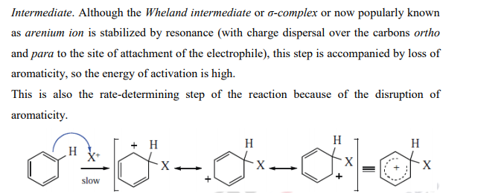
ARENIUM ION MECHANISM :

Slide 5
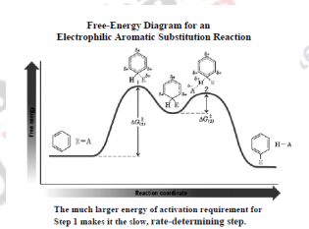
Energy Profile Diagram of the Arenium Ion Mechanism of Electrophilic Aromatic Substitution
https://youtu.be/mY8o-Ew-GZg
The energy diagram of this reaction shows that step 1 is highly endothermic and has a large ∆G ‡ (1) • The first step requires the loss of aromaticity of the very stable benzene ring, which is highly unfavorable • The first step being a slow step, is rate-determining Step 2 is highly exothermic and has a small ∆G ‡ (2) • The ring regains its aromatic stabilization, which is a highly favorable process

Slide 6
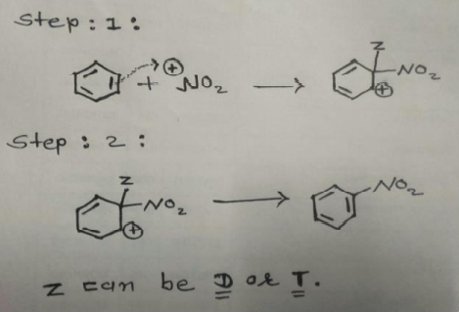
1. Isotope Effects : • “A difference in the rate of a reaction due to a difference in the isotope present in the reaction system is called Isotope Effect.” •If the proton is lost before the arrival of the Electrophile (SE1 mechanism) then there should be a substantial isotope effect. •In This effect, Each Case the C—H bond broken in the Rate determining step but In Arenium Ion mechanism, the C—H bond not broken in the rate determining step, Hence No isotope effect should be found.
As expected , isotope effect has not observed in most aromatic Electrophilic Substitution.
Rates of Nitration of duterio- and tritiobenzenes are the same as the rate of benzene. •This Clearly shows that aromatic electrophilic substitution involves two steps and that the loss of proton is not the rate-determining step. ......☆☆☆☆.....
https://youtu.be/DuuyEbxWCkw

Slide 7
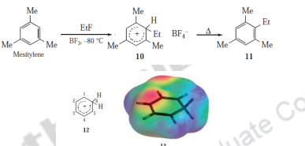
2. Isolation of Arenium Ion Intermediates: The isolation of Arenium ions in many cases provides for a very strong evidence for the Arenium ion mechanism. When 10 was heated, the normal substitution product (11) was obtained. Even the simplest such ion, the benzenonium ion (12) has been prepared in HF ̶ SbF5 ̶ SO2ClF ̶ SO2F2 at -134 °C, where it could be studied spectrally. Fig. 8: Isolation of Arenium ion intermediate

Slide 8
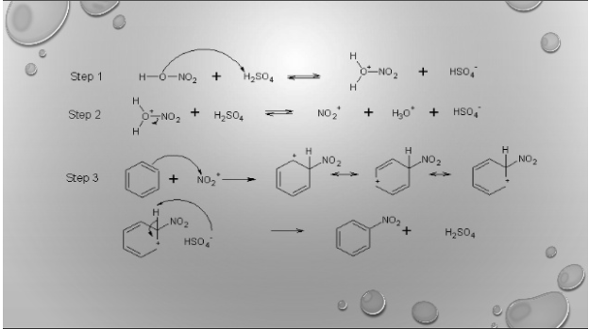

Slide 9
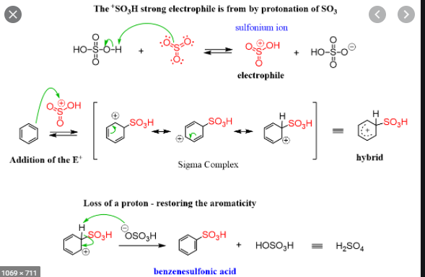

Slide 10
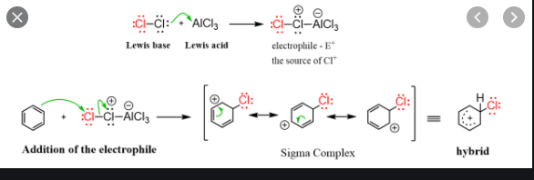
Chlorination of Benzene

Slide 11
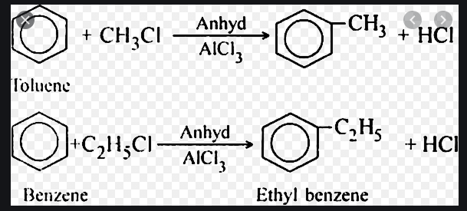
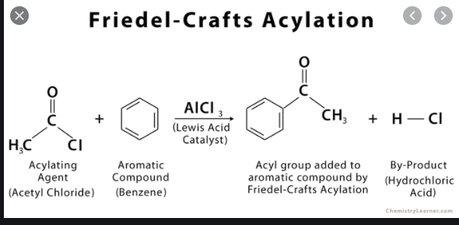
Friedel Crafts Alkylation and Acylation of Benzene
https://youtu.be/UiHST_N22j4

Slide 15
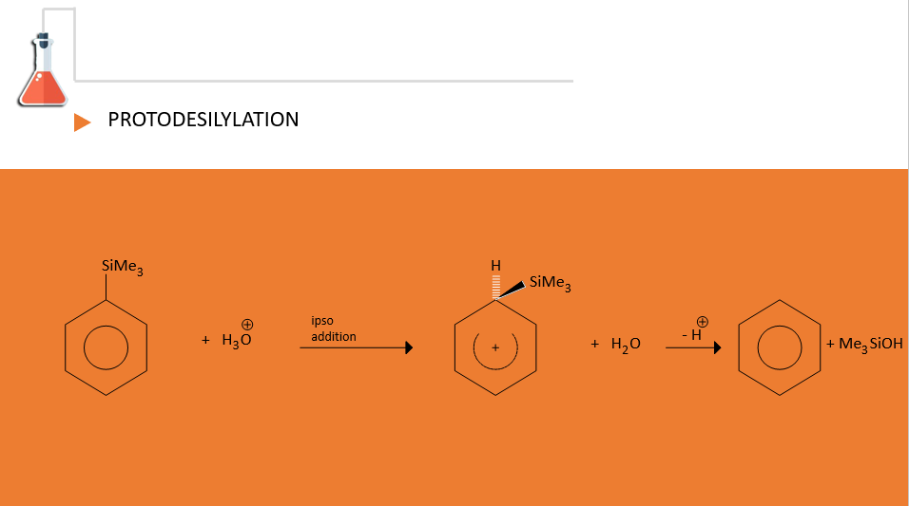
https://youtu.be/w0CFe8Fg1o8

Slide 16
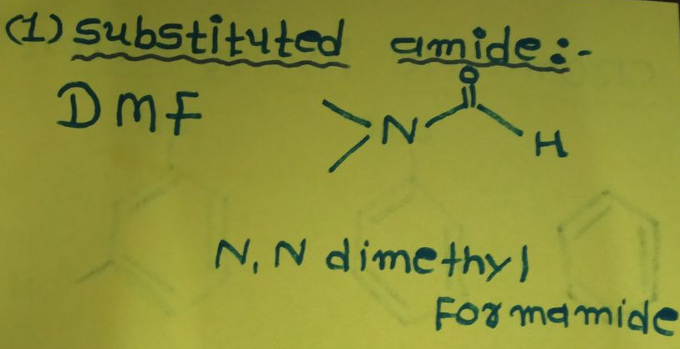
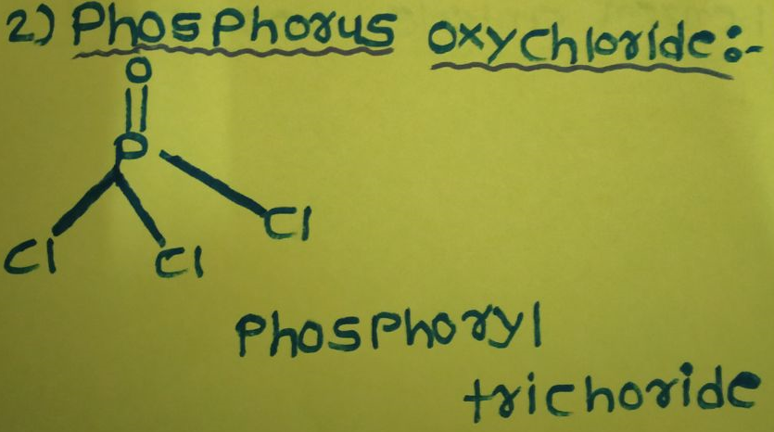
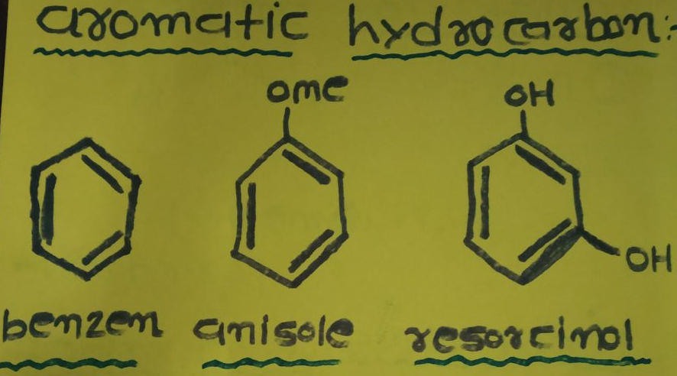

Slide 17
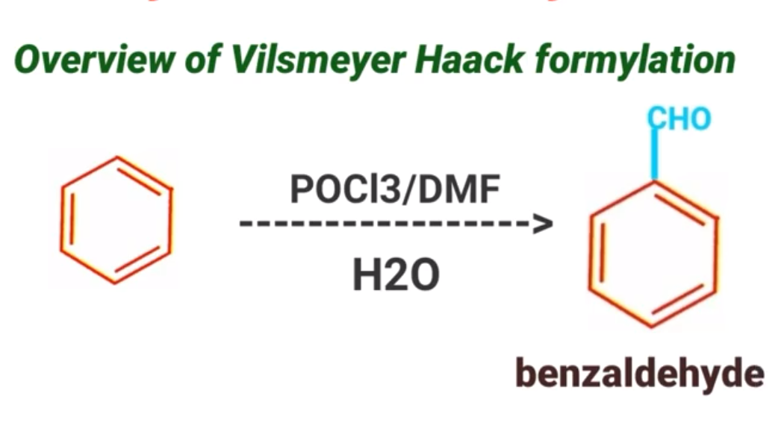
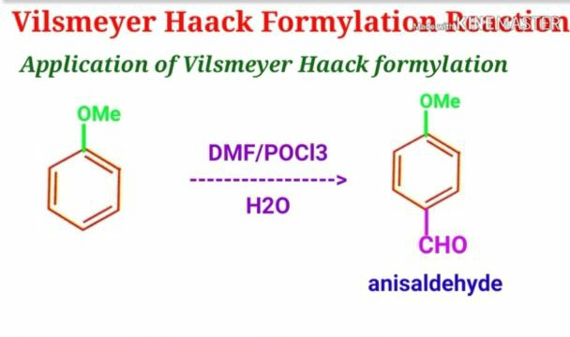

Slide 18
https://youtu.be/ffKpE_XazRQ

Slide 19
Gattermann Koch Reaction

Slide 21
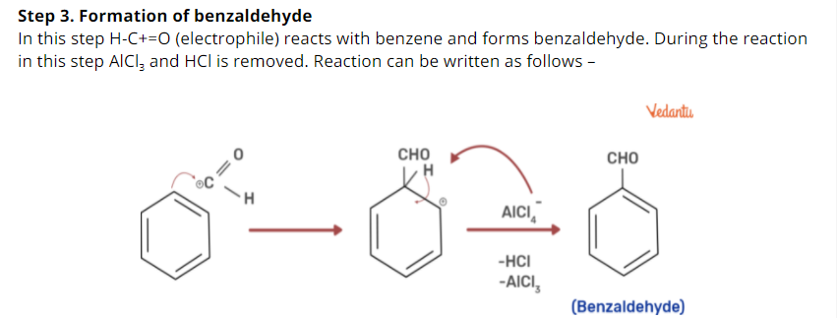
https://youtu.be/fZyBY6VzAXE

